Slide 1
PowerPoint
on
PowerPoint
A guide to creating
engaging, enjoyable,
and exciting presentations
By: Mike Karlin

Slide 2
Step 1
Hi.
Hey.
Keep it Simple

Slide 3
Avoid
Writing every single thing
You’ve ever thought or
Wanted to say. People know
How to read and when you
Have this much text on the
Screen it’s easy to get lost
Inside all of it!
Plus, it’s really boring.

Slide 4
One point per slide
Nothing more to see here, move along…
Is all you need.

Slide 5
Step 2
Nope…
You don’t
move!
Limit animations

Slide 6
Remember...
When you first discovered
PowerPoint could animate
Every single letter like a
typewriter
And it was the worst thing ever.
←Never again!

Slide 7
This goes for
Transitions too!
Goodbye, old friend.
Transition Tom
The point is on the slides,
Not in between them.

Slide 8
Step 3
I’m a racecar
driver!
Ummm...
Use high Quality Pics

Slide 9
The higher the resolution
The better!
I’ve got a
BILLION
pixels!!!!
But I’m a racecar driver...

Slide 10
Step 4
Keep it up
Theme team!
Almost halfway
there!
Great work so
far guys!
Have a theme

Slide 11
Don’t forget
To add some color!
We’re the
Best part!
Black & White
Is so 1998

Slide 12
And please...

Slide 13
Do NOT Use the Microsoft Themes
They are boring.
They have been used for twenty years.
They do not hold people’s attention.
You can do better!
And why all the fossil fish! →

Slide 14
Step 5
WinGdings, I choose you!
Not.
Jerk...
Blah bligg
Pick a good font

Slide 15
?
Can’t Find one
Head over to:
www.beautifulfonts.com
Click me! →
But maybe finish
this first...

Slide 16
Step 6
Wow!
Use charts & Graphs

Slide 17
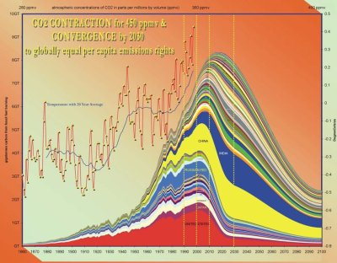
But Remember!
Keep it simple!

Slide 18
Step 7
☹
Are we not
Enough for You
Anymore
??
Use Audio & Video

Slide 19
For example,
A humorous look
At PowerPoint!
→

Slide 20
And Finally!

Slide 21
Step 8
As you can see
On this slide...
Blah, blah blah
Yep... it’s even better
The 28th time. Wow.
Practice, Practice, Practice

Slide 22
And Then
Practice
Some more!

Slide 23
But Wait!
You can
Never forget...
Go on...

Slide 24
To cite your sources!
Royalty Free Images Courtesy of Stock xchng: www.sxc.hu
Garr Reynolds Guide to Presentations: www.garreynolds.com
Teachnology PowerPoint Guide: www.teach-nology.com
ActDen PowerPoint Guide: www.actden.com
Well duh!

Slide 25
Thanks for
Watching!
I can be reached at
Mike.karlin@Gmail.com
Adios!

